Slide 1
Lesson objective
Title: Plotting linear equations
Aim – be able to:
Solve linear equations with unknown variables and brackets on both sides.
Plot coordinates on the cartesian plane

Slide 2



Solve: exercise books
$3x−4=11$
$7x+4=6$
Equation solving steps:
Simplify both sides
Collect variable terms to left and numbers to right – swap sides swap signs.
Simplify both sides
Divide both sides by coefficient.
$$3x=15$$
$$x=\frac{15}{3}$$
$$x=5$$
$$7x=2$$
$$x=\frac{2}{7}$$
Notes:
Run through one at a time. Remember to review whiteboard etiquette.

Slide 3

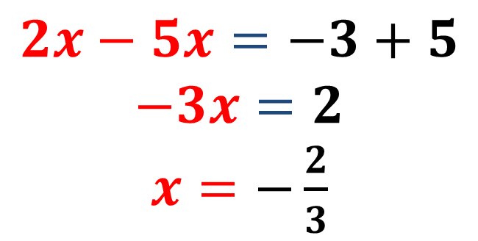
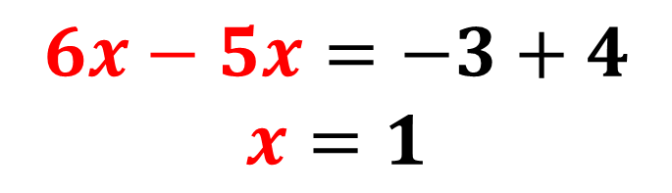
Solve: (exercise books)
$6x−4=5x−3$
$2x−5=5x−3$
Equation solving steps:
Simplify both sides
Collect variable terms to left and numbers to right – swap sides swap signs.
Simplify both sides
Divide both sides by coefficient.
$$6x−5x=−3+4$$
$$x=1$$
$$2x−5x=−3+5$$
$$−3x=2$$
$x=−\frac{2}{3}$
Notes:
Run through one at a time. Remember to review whiteboard etiquette.

Slide 4
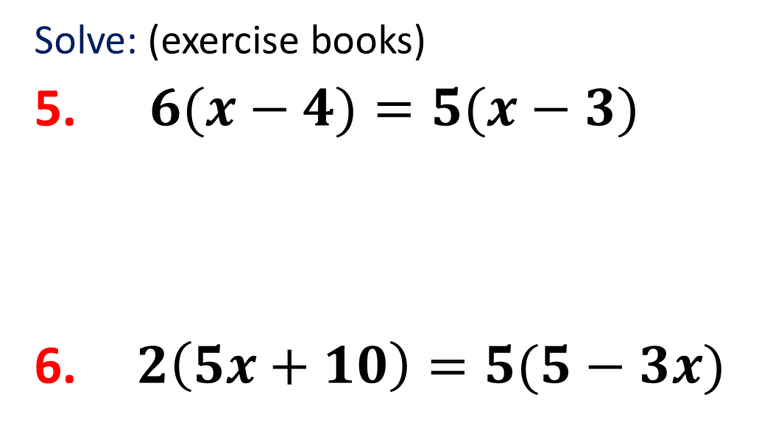
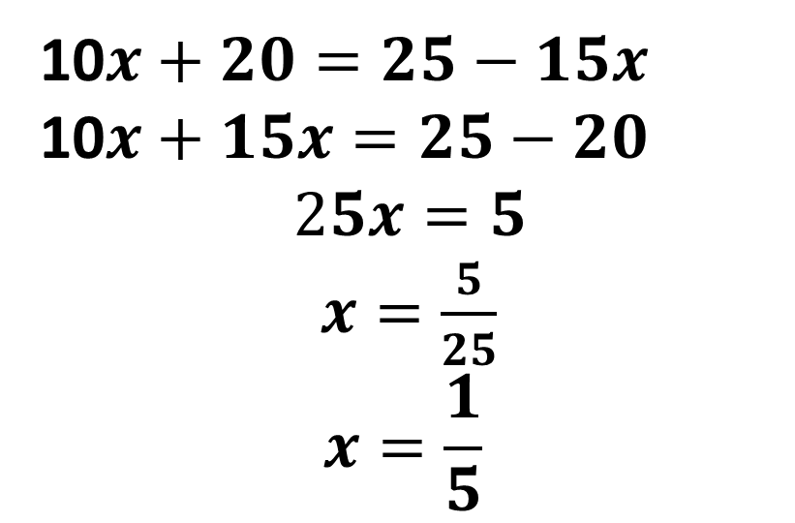

Solve: (exercise books)
$6(x−4)=5(x−3)$
$2\left(5x+10\right)=5(5−3x)$
Equation solving steps:
Simplify both sides
Collect variable terms to left and numbers to right – swap sides swap signs.
Simplify both sides
Divide both sides by coefficient.
$$6x−24=5x−15$$
$$6x−5x=−15+24$$
$$x=9$$
10$x+20=25−15x$
10$x+15x=25−20$
$$25x=5$$
$x=\frac{5}{25}$
$$x=\frac{1}{5}$$
Notes:
Run through one at a time. Remember to review whiteboard etiquette.

Slide 5
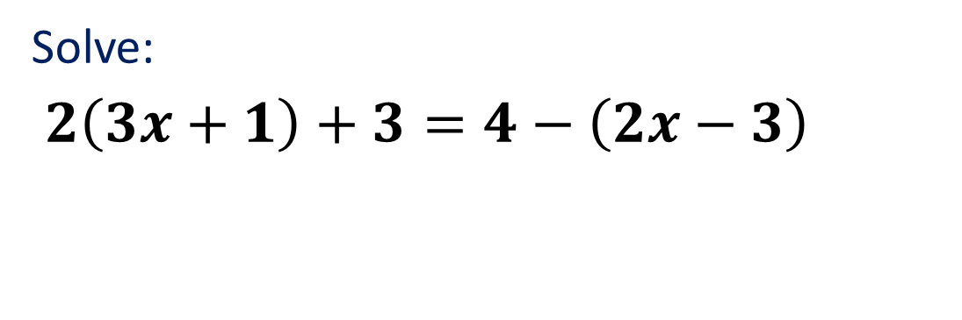
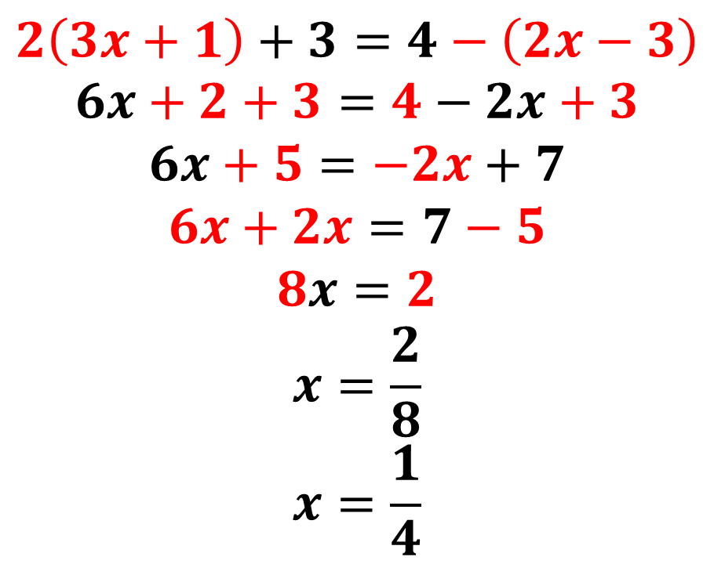
Year 8 A grade – brackets both sides
Solve:
$2\left(3x+1\right)+3=4−\left(2x−3\right)$
Equation solving steps:
Simplify both sides
Collect variable terms to left and numbers to right – swap sides swap signs.
Simplify both sides
Divide both sides by coefficient.
$$2\left(3x+1\right)+3=4−\left(2x−3\right)$$
$$6x+2+3=4−2x+3$$
$$6x+5=−2x+7$$
$$6x+2x=7−5$$
$$8x=2$$
$$x=\frac{2}{8}$$
$$x=\frac{1}{4}$$
Notes:
Run through one at a time. Remember to review whiteboard etiquette.

Slide 6
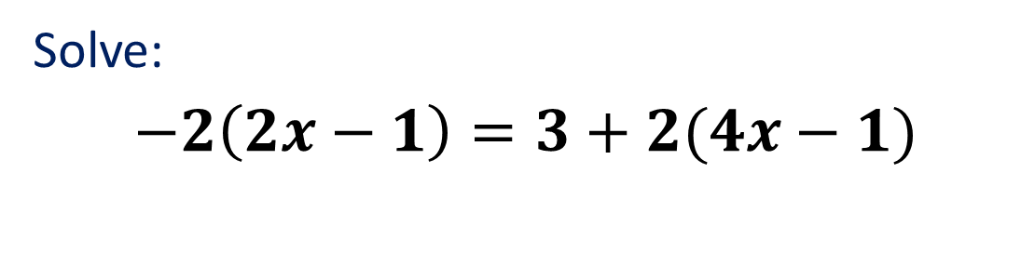
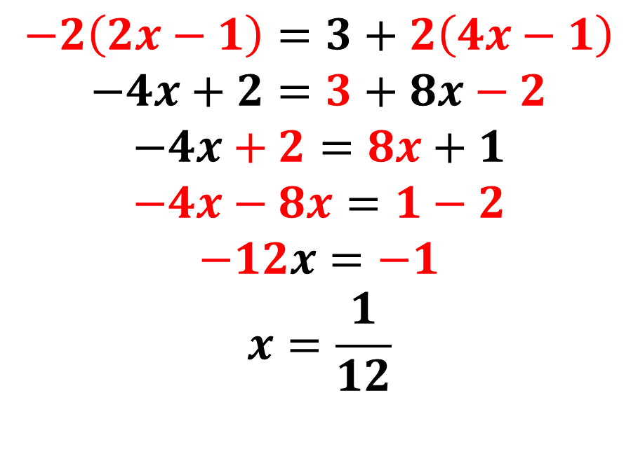
Year 8 A grade – brackets both sides
Solve:
$−2\left(2x−1\right)=3+2(4x−1)$
Equation solving steps:
Simplify both sides
Collect variable terms to left and numbers to right – swap sides swap signs.
Simplify both sides
Divide both sides by coefficient.
$$−2\left(2x−1\right)=3+2\left(4x−1\right)$$
$$−4x+2=3+8x−2$$
$$−4x+2=8x+1$$
$$−4x−8x=1−2$$
$$−12x=−1$$
$$x=\frac{1}{12}$$
Notes:
Run through one at a time. Remember to review whiteboard etiquette.

Slide 7
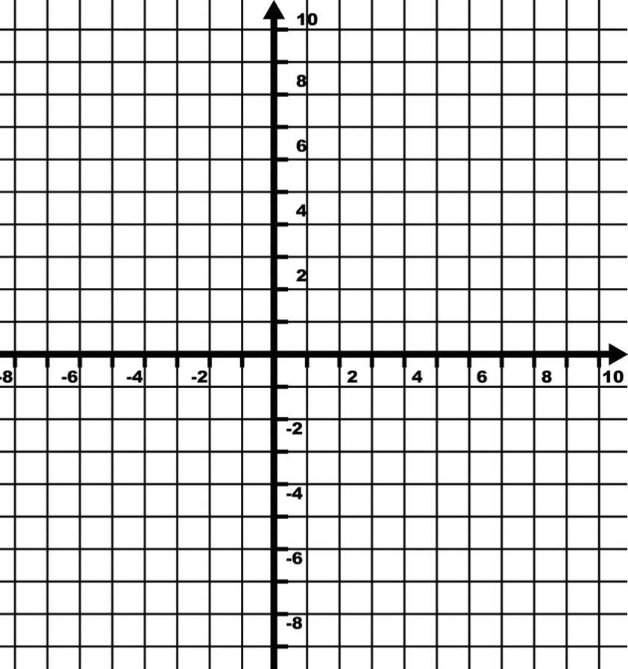
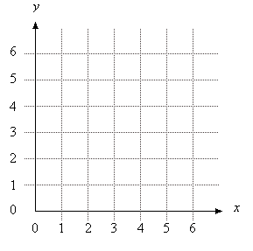
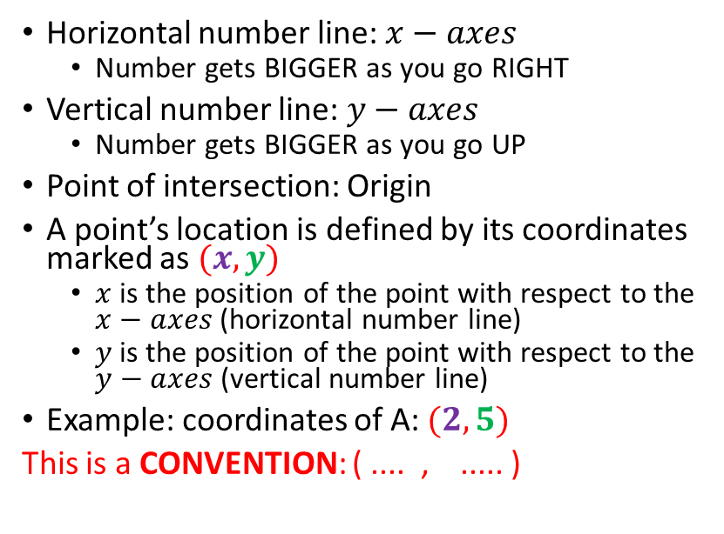
Using Coordinates
E
Horizontal number line: $x−axes$
Number gets BIGGER as you go RIGHT
Vertical number line: $y−axes$
Number gets BIGGER as you go UP
Point of intersection: Origin
A point’s location is defined by its coordinates marked as $(x,y)$
$x$ is the position of the point with respect to the $x−axes$ (horizontal number line)
$y$ is the position of the point with respect to the $y−axes$ (vertical number line)
Example: coordinates of A: $(2, 5)$
This is a CONVENTION: ( .... , ..... )
A
A
D
C
B
Origin
(0,0)
©AXM

Slide 8
Using Coordinates
ANSWERS
E
Horizontal number line: $x−axes$
Number gets BIGGER as you go RIGHT
Vertical number line: $y−axes$
Number gets BIGGER as you go UP
Point of intersection: Origin
A point’s location is defined by its coordinates marked as $(x,y)$
$x$ is the position of the point with respect to the $x−axes$ (horizontal number line)
$y$ is the position of the point with respect to the $y−axes$ (vertical number line)
Example: coordinates of A: $(2, 5)$
This is a CONVENTION: ( .... , ..... )
A
A
A (2,5); B(2,-5); C(-4,-2); D (-7,0); E (-1, 9)
D
C
B
Origin
(0,0)
©AXM

Slide 9
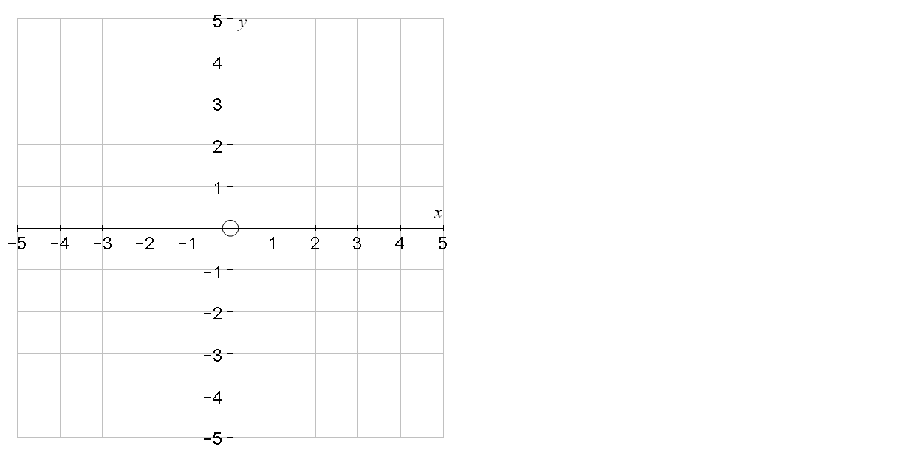
Coordinates in all 4 quadrants
Eg write down the coordinates of A, B, C and D
Eg Plot the coordinates:
(3,4)
F(0,4)
A
E(4,1)
D
(-3,2)
F(0,4)
E(4,1)
G(-2,-1)
H(4,-4)
G(-2,-1)
B
(1,-2)
(-5,-3)
C
H(4,-4)

Slide 10
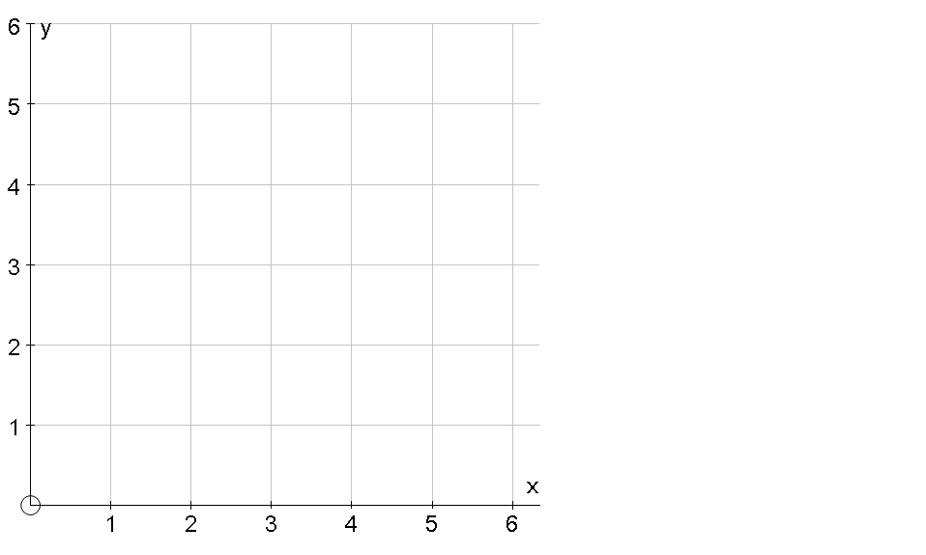
Find the point needed to make a rectangle
(6,3)

Slide 11
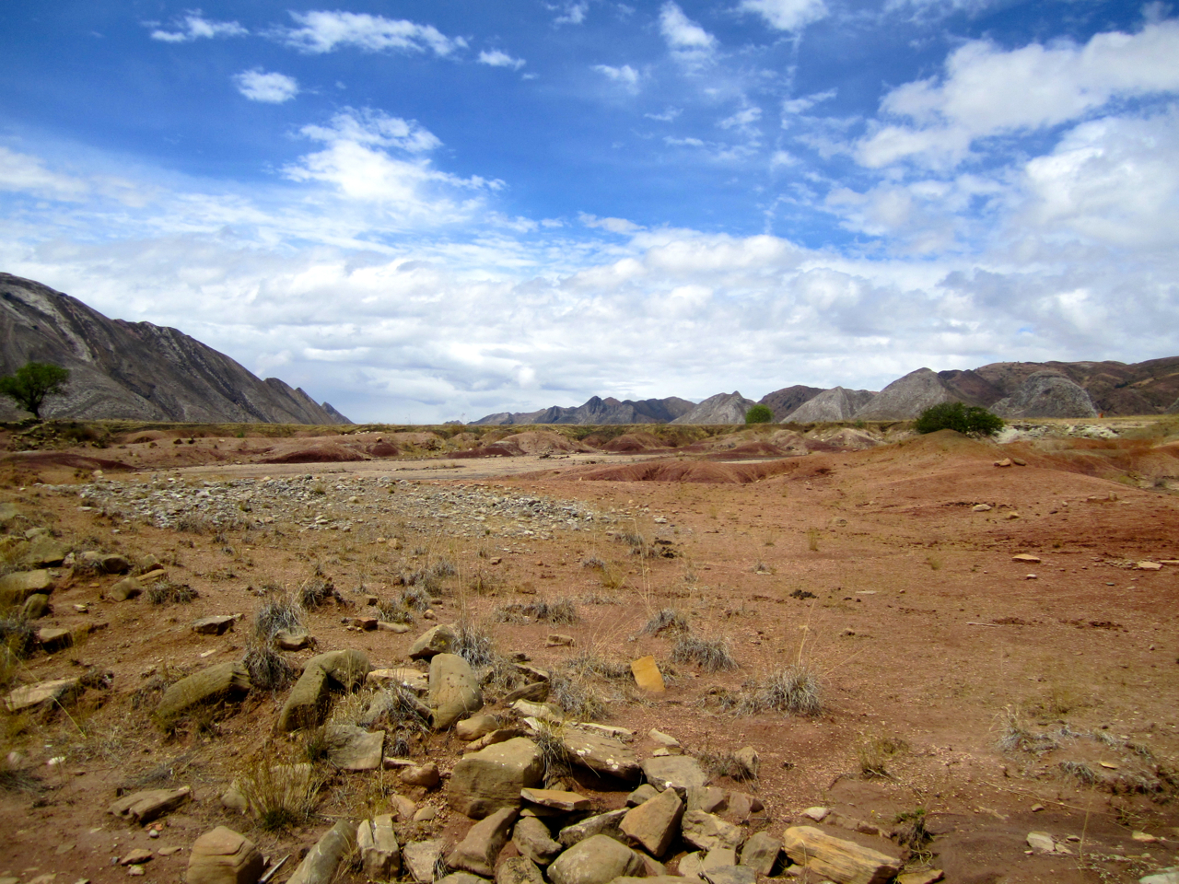
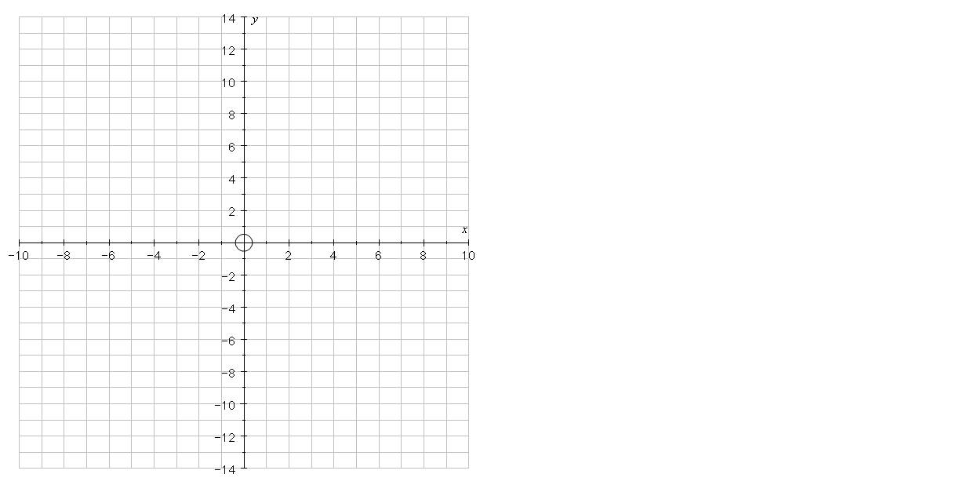

Coordinates
Connect the coordinates in order to draw a mystery creature
Body: (5,7) (5,6) (6,4) (2, -4) (0,-5) (-1,-6) (-2,-9) (-1,-11)
(0,-12) (0,-13) (-3,-12) (-3,-11)
(-4,-9) (-4,-6) (-6,-9) (-8,-11)
(-8,-12) (-1,-14) (-7,-14)
(-10,-13) (-10,-11) (-8,-9)
(-6,-3) (-5,1) (-3,3) (2,6) (2,10) (3,11) (5,12) (9,10) (9,9) (6,9) (9,8) (8,7) (5,7)
Arm:
(3,3) (5,1) (7,1) (7,0) (4,0) (2,2)
Front Leg:
(2,-4) (3,-11) (4,-12) (4,-13)
(1,-12) (1,-11) (0,-5)

Slide 12
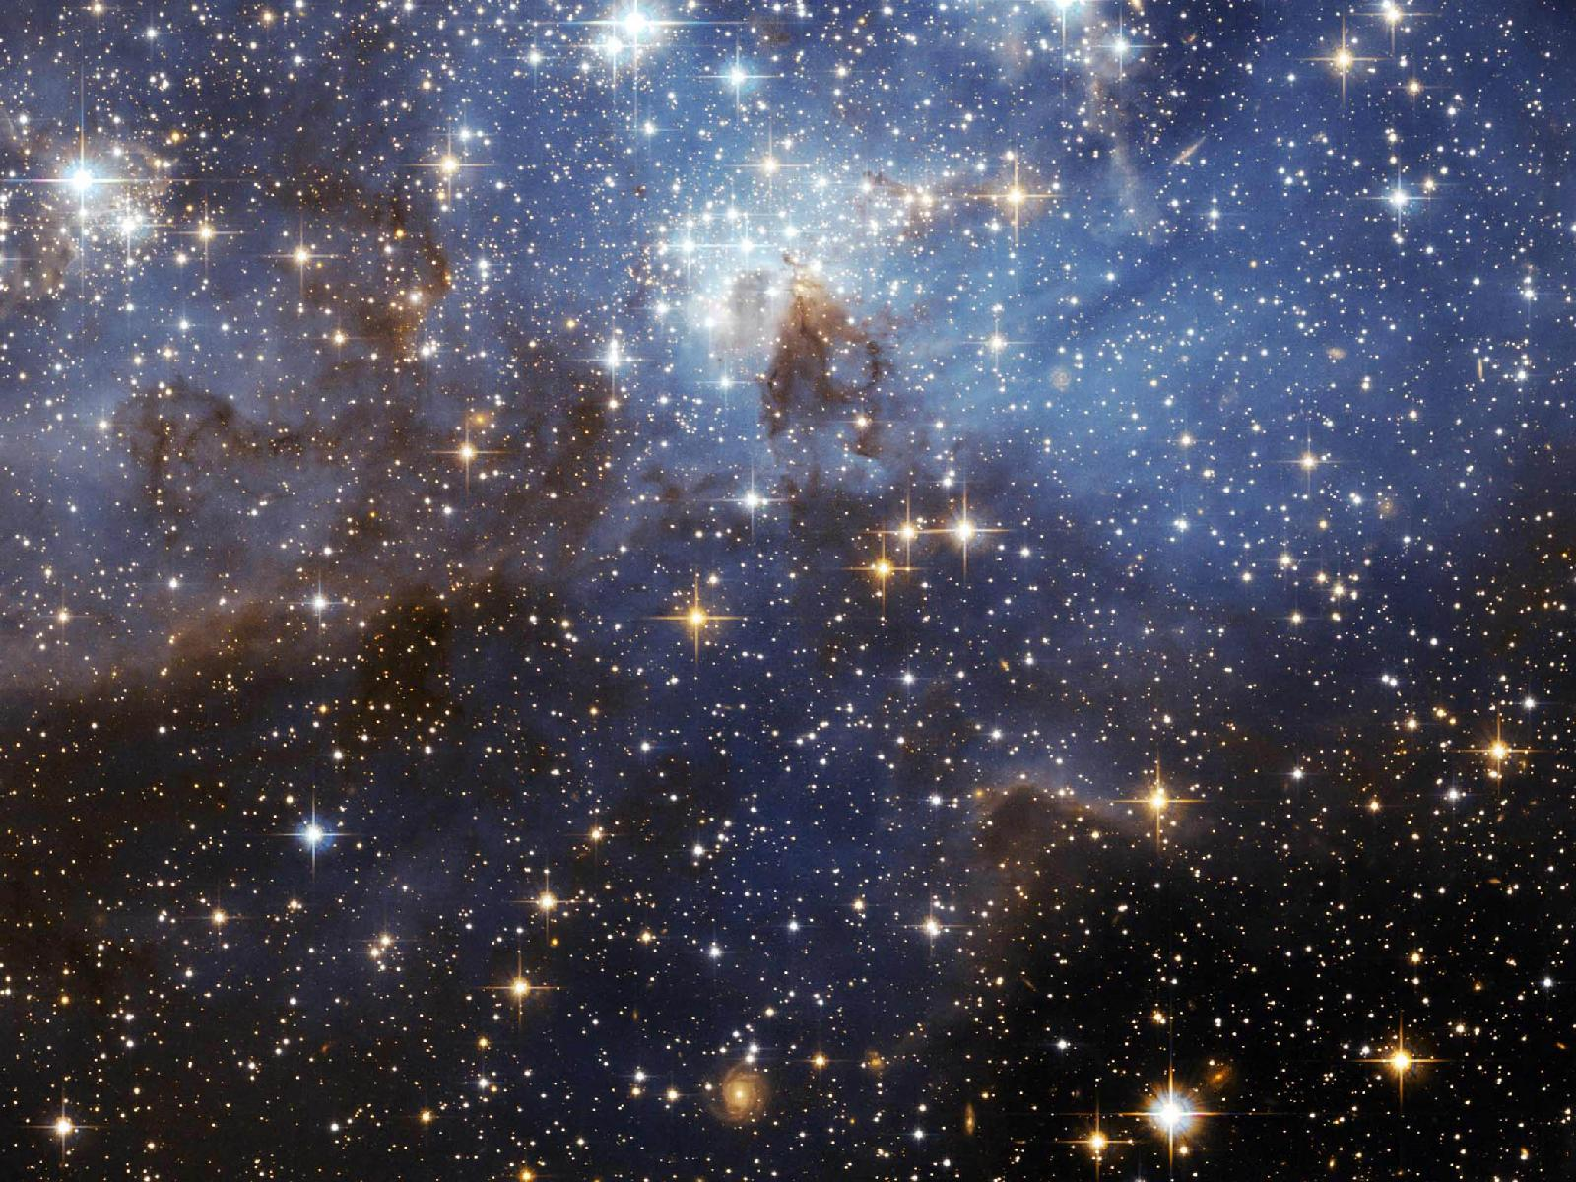
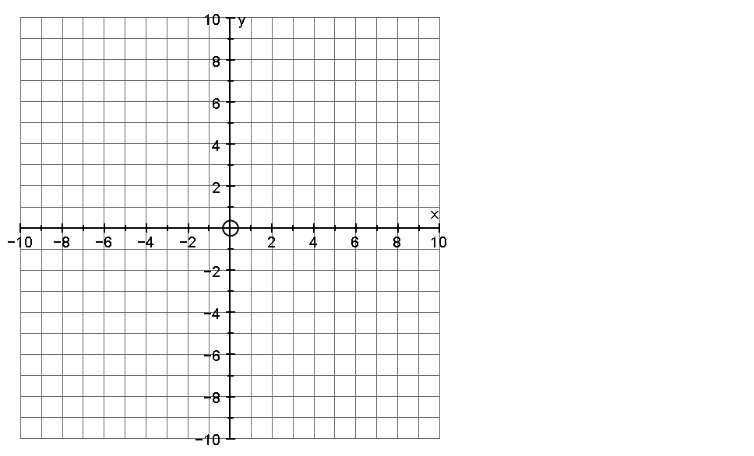
Coordinates
Connect the coordinates in order to draw a mystery object
Part 1: (0,10) (2,5) (2,0) (4, -2) (9,-2) (10,-4) (8,-6) (4,-5)
(1,-2) (2,-5) (3,-10) (1,-7)
(1,-10) (0,-9) (-1,-10) (-1,-7)
(-3,-10) (-2,-5) (-1,-2)
(-4,-5) (-8,-6) (-10,-4)
(-9,-2) (-4,-2) (-2,0) (-2,5) (0,10)
Part 2:
(6,-2) (6,3) (7,6) (8,3) (8,-2)
Part 3:
(-6,-2) (-6,3) (-7,6) (-8,3) (-8,-2)
Part 4:
(-8,-6) (-8,-8) (-7,-7) (-6,-8) (-6,-5½)
Part 5:
(8,-6) (8,-8) (7,-7) (6,-8) (6,-5½)

Slide 13
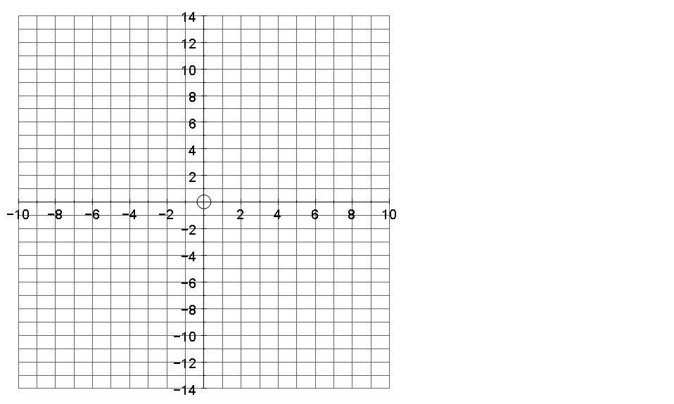
Coordinates
Connect the coordinates in order to draw a mystery creature
Body: (5,7) (5,6) (6,4) (2, -4) (0,-5) (-1,-6) (-2,-9) (-1,-11)
(0,-12) (0,-13) (-3,-12) (-3,-11)
(-4,-9) (-4,-6) (-6,-9) (-8,-11)
(-8,-12) (-1,-14) (-7,-14)
(-10,-13) (-10,-11) (-8,-9)
(-6,-3) (-5,1) (-3,3) (2,6) (2,10) (3,11) (5,12) (9,10) (9,9) (6,9) (9,8) (8,7) (5,7)
Arm:
(3,3) (5,1) (7,1) (7,0) (4,0) (2,2)
Front Leg:
(2,-4) (3,-11) (4,-12) (4,-13)
(1,-12) (1,-11) (0,-5)

Slide 14
Coordinates
Connect the coordinates in order to draw a mystery object
Part 1: (0,10) (2,5) (2,0) (4, -2) (9,-2) (10,-4) (8,-6) (4,-5)
(1,-2) (2,-5) (3,-10) (1,-7)
(1,-10) (0,-9) (-1,-10) (-1,-7)
(-3,-10) (-2,-5) (-1,-2)
(-4,-5) (-8,-6) (-10,-4)
(-9,-2) (-4,-2) (-2,0) (-2,5) (0,10)
Part 2:
(6,-2) (6,3) (7,6) (8,3) (8,-2)
Part 3:
(-6,-2) (-6,3) (-7,6) (-8,3) (-8,-2)
Part 4:
(-8,-6) (-8,-8) (-7,-7) (-6,-8) (-6,-5½)
Part 5:
(8,-6) (8,-8) (7,-7) (6,-8) (6,-5½)

